Slide 1

ZOMBIELAND
ABES Engineering College, Ghaziabad, UP
Computer Engineering Department
Mini-Project Presentation
Project Domain: WEB DEVELOPMENT,PYTHON
Project Group No:13
Project guide:
Mr. Anurag Gupta
Team members:
Prakhar Mehrotra(2200320150045)
Rohit Kumar (2200320150052)

Slide 2
Content
Abstract
Introduction
Objectives
Existing Work related to Project
Requirements of Project
Methodology
Expected Outcome
References

Slide 3


Introduction to the
Zombie land Game
In this game we have introduced an web based game of killing zombies on shooting them with shots and player can reload the shots and enjoy the game . In this game we have build up to 5 level when player finishes all five levels he/she will be the winner of the game .

Slide 4

Abstract
1
Game Concept
The game is set in a post-apocalyptic world where players must use their strategic thinking and survival skills to conquer relentless waves of zombies.
2
Engaging Experience
Players will be fully immersed in the game's intense atmosphere, featuring stunning visuals, terrifying sound effects, and challenging objectives.
3
Collaborative Gameplay
Opportunities for players to team up, strategize, and fight off zombie threats together for a richer and more immersive gaming experience.

Slide 5

Introduction
1
The Post-Apocalyptic World
Enter a world destroyed by a zombie outbreak, where the remnants of society struggle to survive amidst chaos and devastation.
2
Survival as the Ultimate Goal
Players must navigate the dangerous landscape, scavenge for supplies, and defend against the relentless attacks of the undead.
3
Community and Cooperation
Form alliances with other players to increase your chances of survival and thrive in the harsh new reality.

Slide 6
Objectives
Mission Challenges
Zombie Boss Fights
Community Building
Players will encounter a series of challenging missions, each with distinct objectives, such as rescuing survivors, gathering vital supplies, and fortifying safe zones.
Confronting formidable zombie bosses with enhanced abilities and strengths, offering intense and rewarding battles for players to tackle.
Encouraging social interaction and collaboration among players, fostering a sense of community and camaraderie in the face of overwhelming adversity.

Slide 7
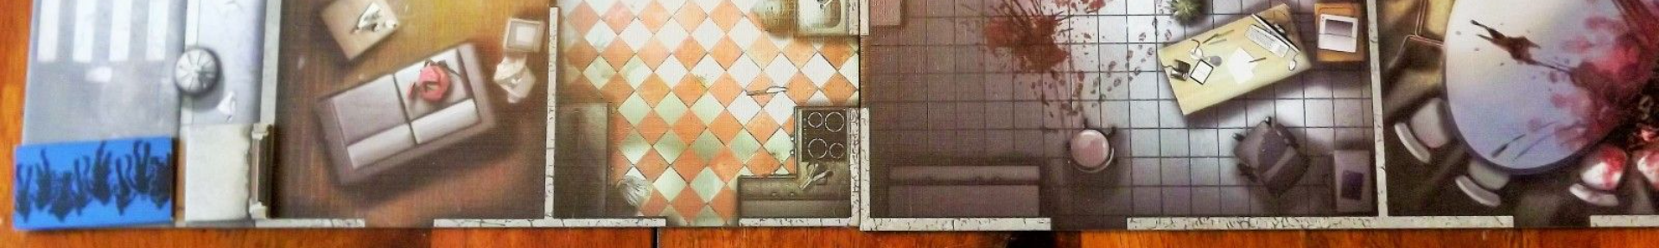



Existing Work Related to the Zombie Kill Project
Research
Storyline Development
Graphic Design
Thorough analysis of existing zombie-themed games and player feedback to create an engaging and unique gaming experience.
Collaboration with creative writers and artists to craft a compelling, immersive, and emotionally charged narrative for the game's storyline.
Working with talented illustrators and designers to develop stunning visuals and animations that bring the game world to life.

Slide 8


Slide 9
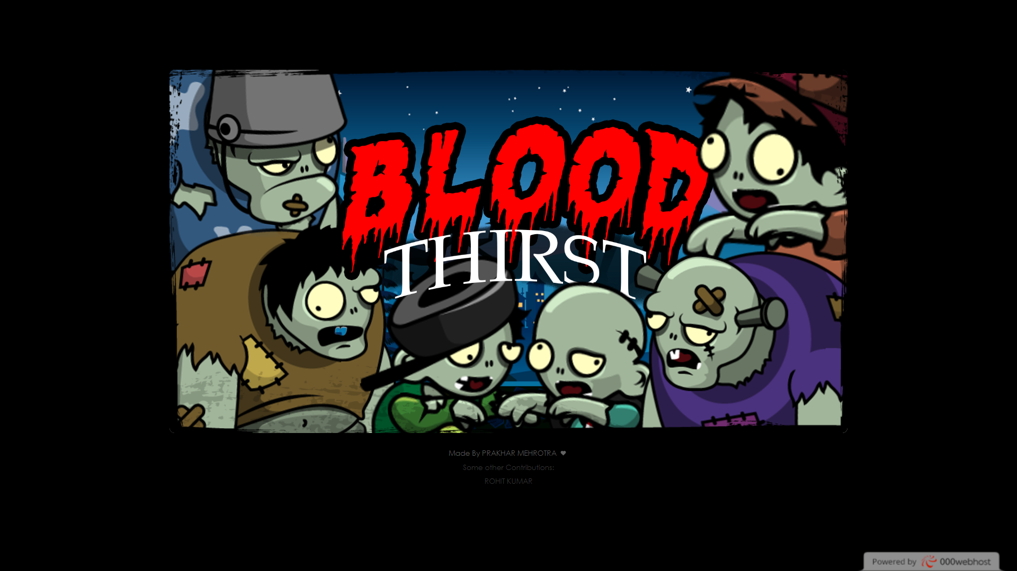
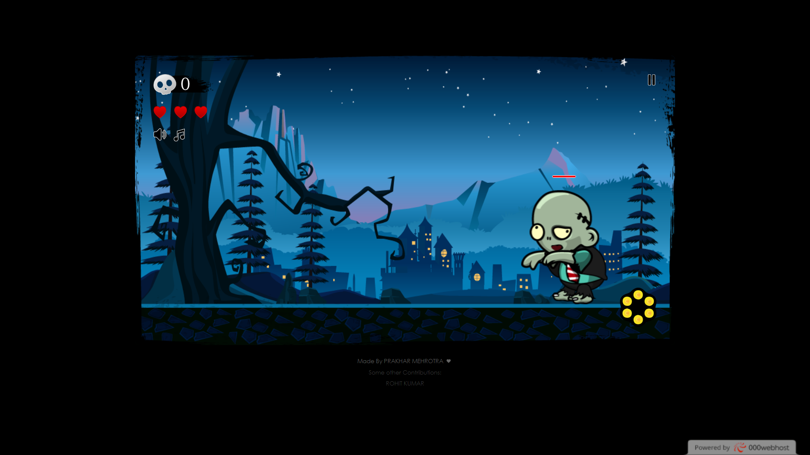
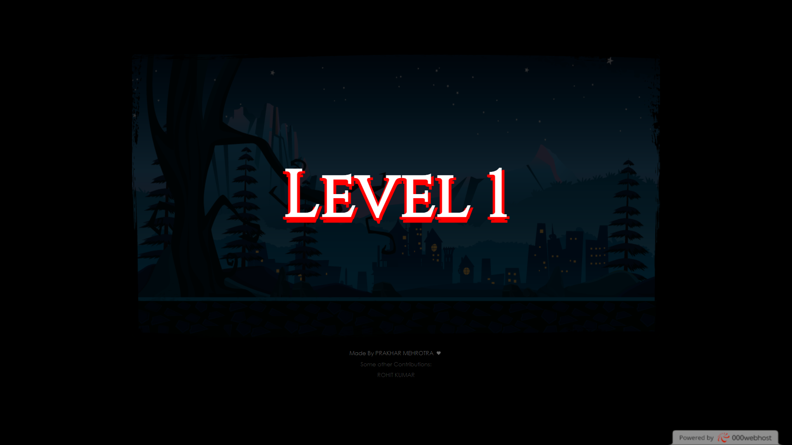

Slide 10


Slide 11
Requirements of Project
Gameplay Mechanics
Visual Design
Multiplayer Functionality
Provide a seamless and responsive gameplay experience, including movement, combat, resource management, and base building.
Create immersive and detailed environments, character models, and animations to enhance the overall gaming experience.
Enable seamless multiplayer interaction, including the ability to form alliances, trade resources, and engage in cooperative gameplay.

Slide 12
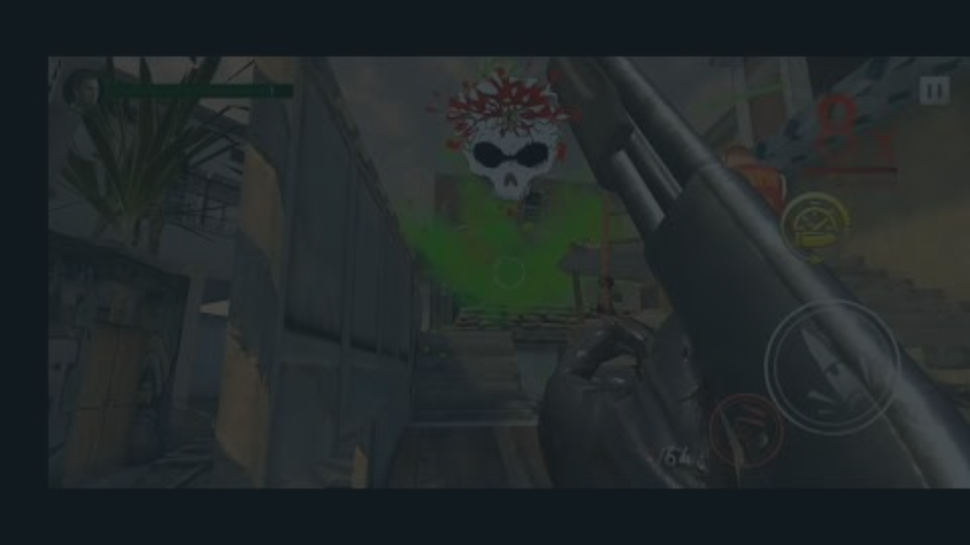



Methodology
Conceptualization
Prototyping
Iterative Development
Create and test prototypes to refine gameplay elements, identify potential issues, and gather feedback from early users.
Brainstorm and develop the core concepts, themes, and mechanics that will define the game experience.
Implement an iterative development process, continuously improving and expanding the game based on player feedback and testing.

Slide 13
Expected Outcome
10K
1K
999
Downloads
User Ratings
Active Players
Anticipating a high volume of game downloads, indicating widespread adoption and player engagement.
Striving for exceptional user ratings, reflecting a positive reception and satisfaction with the immersive gaming experience.
Aspiring for a robust community of active players to foster camaraderie, competition, and ongoing game development support.

Slide 14
References
“The Art of Zombie Gaming” by A. Johnson
1.
2.
“Surviving the Apocalypse: Strategies for Zombie Games” by T. Smith
3.
“Game Development Trends: Zombie Apocalypse Edition” by K. Brown

Slide 15

Thank You !
Thank you for your time and consideration. We are excited about the opportunity to create an immersive and thrilling gaming experience that will captivate players and set new standards in the zombie survival genre.

